Slide 1
Static routing using VLSM
LAB 7

Slide 2
Poll 1
Subnetting is the practice of dividing a network into two or more networks
Yes
No

Slide 3
VLSM subnetting (variable length subnet mask)
Step 1:decide total number of sub net required , lets say 2
Step 2: calculate required network bits for example in assumed case network one need 64 IP’s and rest IP’s belong to network two
32-6=26 bits
(2^n formula used and 32 is (8.8.8.8 total no of bits ))
Step 3: calculate subnet mask by converting this binary number to decimal for eg.
11000000 =192 hence mask will be: 255.255.255.192
Step 4: Find range by subtracting calculated mask from maximum possible number 255.255.255.255
255.255.255.255
255.255.255.192
-----------------------
0.0.0.63
Range will be
192.10.10.0 to 192.10.0.63

Slide 4
Poll 2
variable-length subnet masks is capable of mitigating the IP wastage issue
Yes
No

Slide 5
VLSM subnetting
Step 1:decide total number of sub net required , lets say 2
Step 2: calculate required network bits for example is assumed case network one need 30 IP’s and rest IP’s belong to network two
32-5=27 bits
(2^n formula used and 32 is (8.8.8.8 total no of bits ))
Step 3: calculate subnet mask by converting this binary number to decimal for eg.
11100000 =224 hence mask will be: 255.255.255.224
Step 4: Find range by subtracting calculated mask from maximum possible number 255.255.255.255
255.255.255.255
255.255.255.224
-----------------------
0.0.0.31
Range will be
192.10.10.64 to 192.10.0.95

Slide 6
Poll 3
What will be sub netmask for class C, 8 host network
248
250
252
254

Slide 7
VLSM subnetting
Step 1:decide total number of sub net required , lets say 2
Step 2: calculate required network bits for example is assumed case network one need 8 IP’s and rest IP’s belong to network two
32-3=29 bits
(2^n formula used and 32 is (8.8.8.8 total no of bits ))
Step 3: calculate subnet mask by converting this binary number to decimal for eg.
11111000 =248 hence mask will be: 255.255.255.248
Step 4: Find range by subtracting calculated mask from maximum possible number 255.255.255.255
255.255.255.255
255.255.255.248
-----------------------
0.0.0.7
Range will be
192.10.10.96 to 192.10.0.103

Slide 8
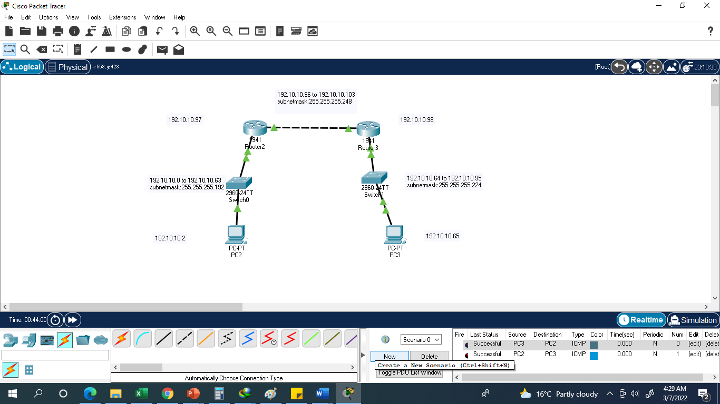


Slide 9
VLSM subnetting (variable length subnet mask)
Step 1:decide total number of sub net required , lets say 2
Step 2: calculate required network bits for example in assumed case network one need 64 IP’s and rest IP’s belong to network two
32-6=26 bits
(2^n formula used and 32 is (8.8.8.8 total no of bits ))
Step 3: calculate subnet mask by converting this binary number to decimal for eg.
11000000 =192 hence mask will be: 255.255.255.192
Step 4: Find range by subtracting calculated mask from maximum possible number 255.255.255.255
255.255.255.255
255.255.255.192
-----------------------
0.0.0.63
Range will be
192.10.10.0 to 192.10.0.63

Slide 10
VLSM subnetting
Step 1:decide total number of sub net required , lets say 2
Step 2: calculate required network bits for example is assumed case network one need 30 IP’s and rest IP’s belong to network two
32-5=27 bits
(2^n formula used and 32 is (8.8.8.8 total no of bits ))
Step 3: calculate subnet mask by converting this binary number to decimal for eg.
11100000 =224 hence mask will be: 255.255.255.224
Step 4: Find range by subtracting calculated mask from maximum possible number 255.255.255.255
255.255.255.255
255.255.255.224
-----------------------
0.0.0.31
Range will be
192.10.10.64 to 192.10.0.95

Slide 11
Poll 4
What will be sub netmask for class C, two host network
248
250
252
254

Slide 12
VLSM subnetting
Step 1:decide total number of sub net required , lets say 2
Step 2: calculate required network bits for example is assumed case network one need 4 IP’s and rest IP’s belong to network two
32-2=30 bits
(2^n formula used and 32 is (8.8.8.8 total no of bits ))
Step 3: calculate subnet mask by converting this binary number to decimal for eg.
11111100 =252 hence mask will be: 255.255.255.252
Step 4: Find range by subtracting calculated mask from maximum possible number 255.255.255.255
255.255.255.255
255.255.255.252
-----------------------
0.0.0.3
Range will be
192.10.10.96 to 192.10.0.99

Slide 13
VLSM subnetting
Step 1:decide total number of sub net required , lets say 2
Step 2: calculate required network bits for example is assumed case network one need 4 IP’s and rest IP’s belong to network two
32-2=30 bits
(2^n formula used and 32 is (8.8.8.8 total no of bits ))
Step 3: calculate subnet mask by converting this binary number to decimal for eg.
11111100 =252 hence mask will be: 255.255.255.252
Step 4: Find range by subtracting calculated mask from maximum possible number 255.255.255.255
255.255.255.255
255.255.255.252
-----------------------
0.0.0.3
Range will be
192.10.10.100 to 192.10.0.103

Slide 14
VLSM subnetting
Step 1:decide total number of sub net required , lets say 2
Step 2: calculate required network bits for example is assumed case network one need 4 IP’s and rest IP’s belong to network two
32-2=30 bits
(2^n formula used and 32 is (8.8.8.8 total no of bits ))
Step 3: calculate subnet mask by converting this binary number to decimal for eg.
11111100 =252 hence mask will be: 255.255.255.252
Step 4: Find range by subtracting calculated mask from maximum possible number 255.255.255.255
255.255.255.255
255.255.255.252
-----------------------
0.0.0.3
Range will be
192.10.10.104 to 192.10.0.107

Slide 15
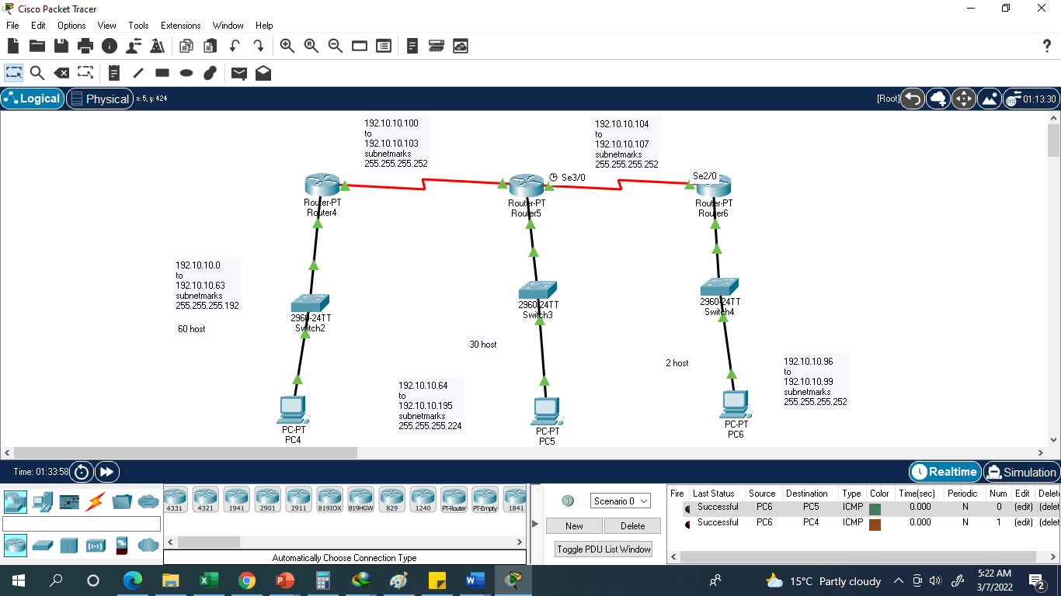

Slide 16
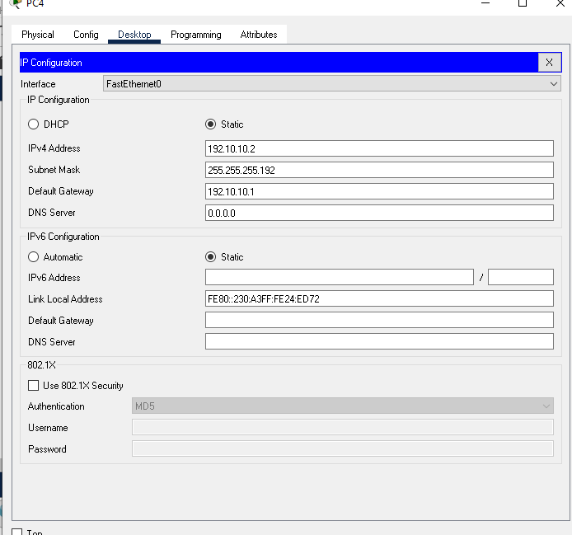

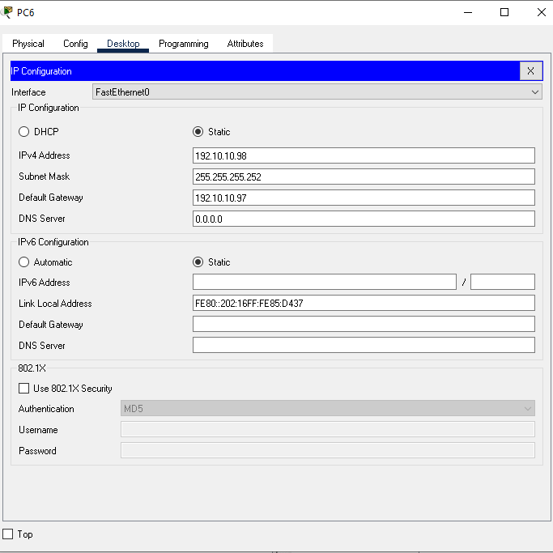

Slide 17
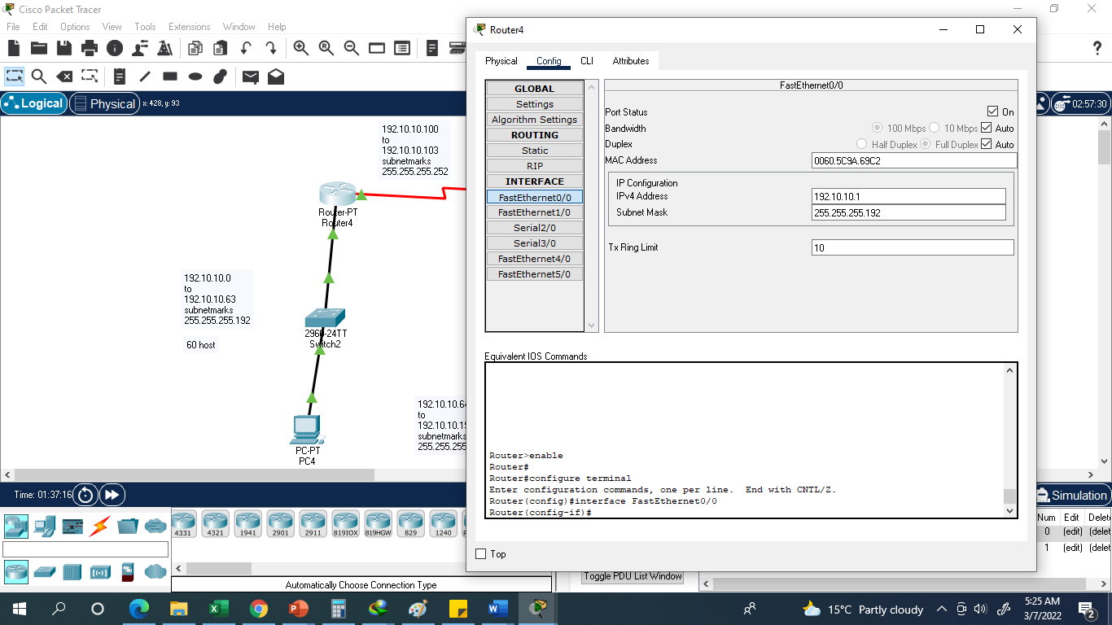

Slide 18
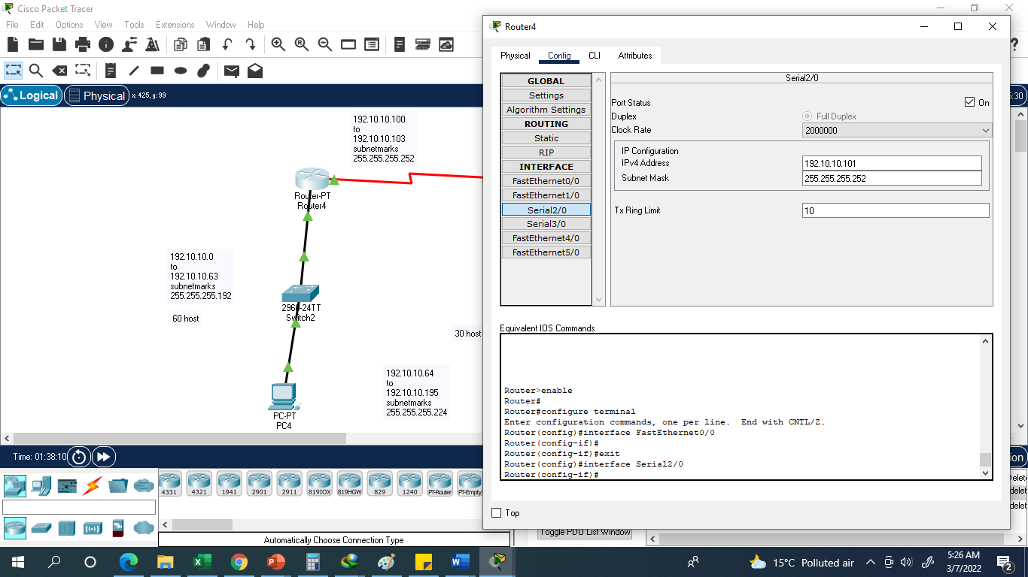

Slide 19
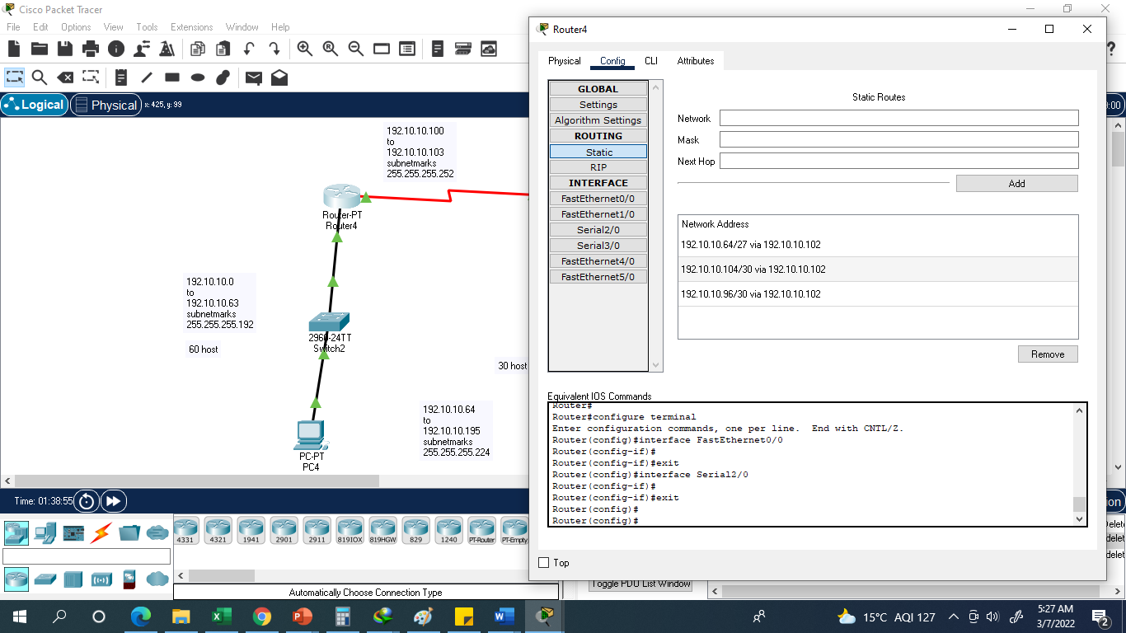

Slide 20
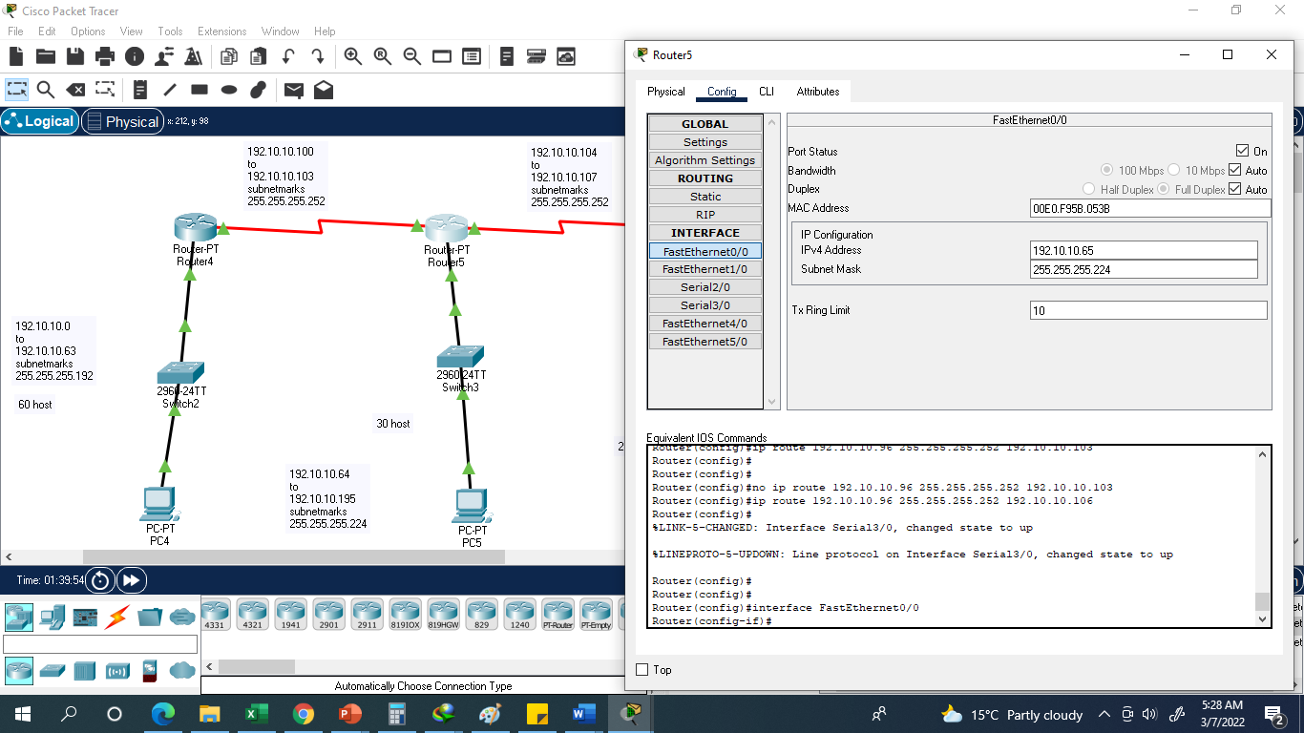

Slide 21
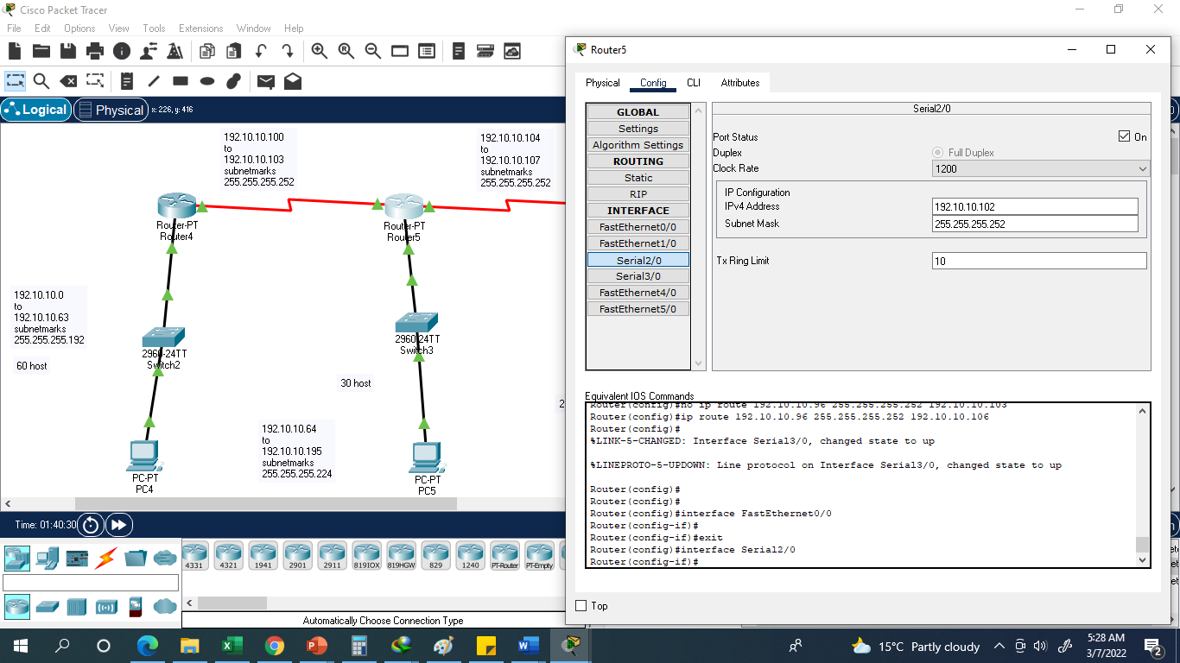

Slide 22
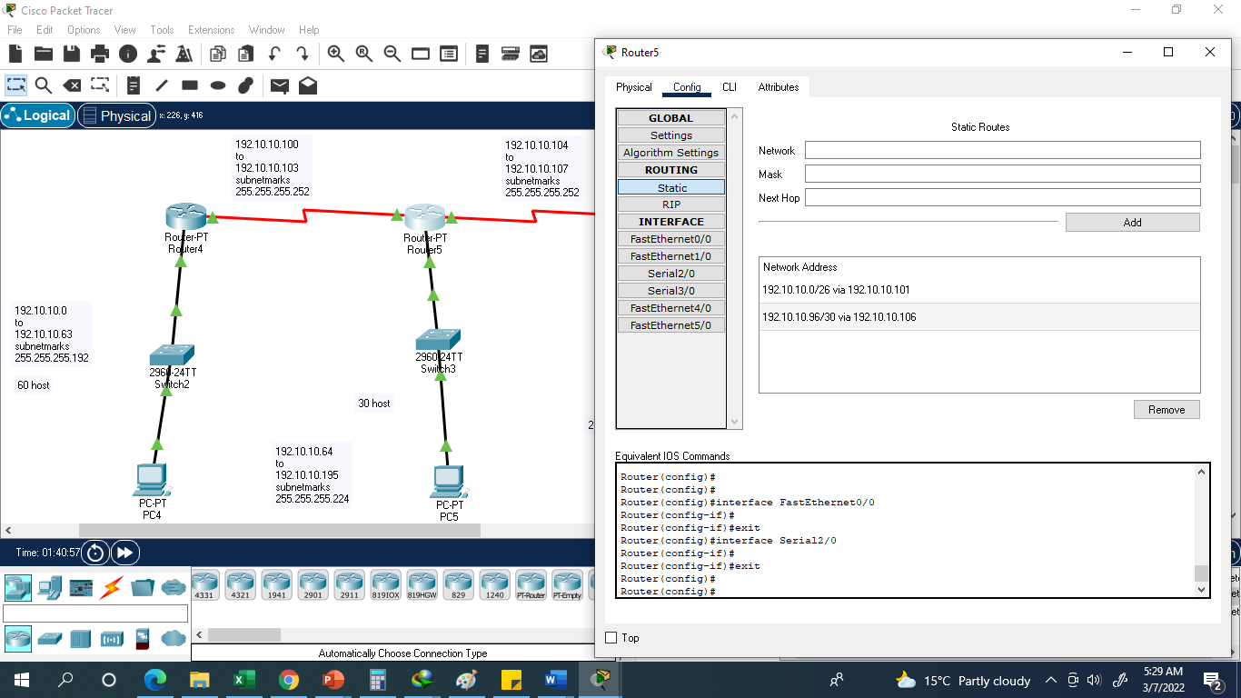

Slide 23
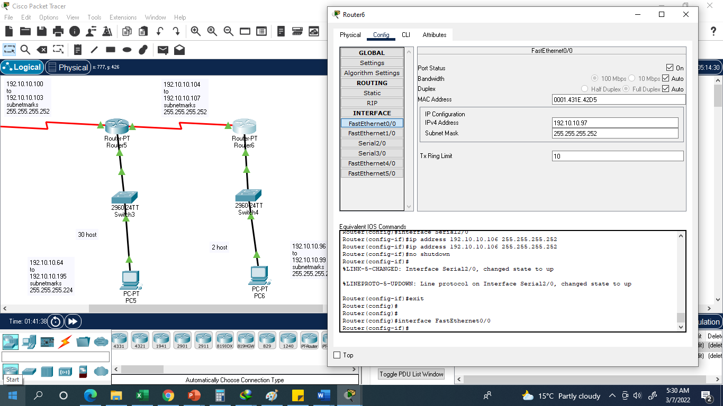

Slide 24
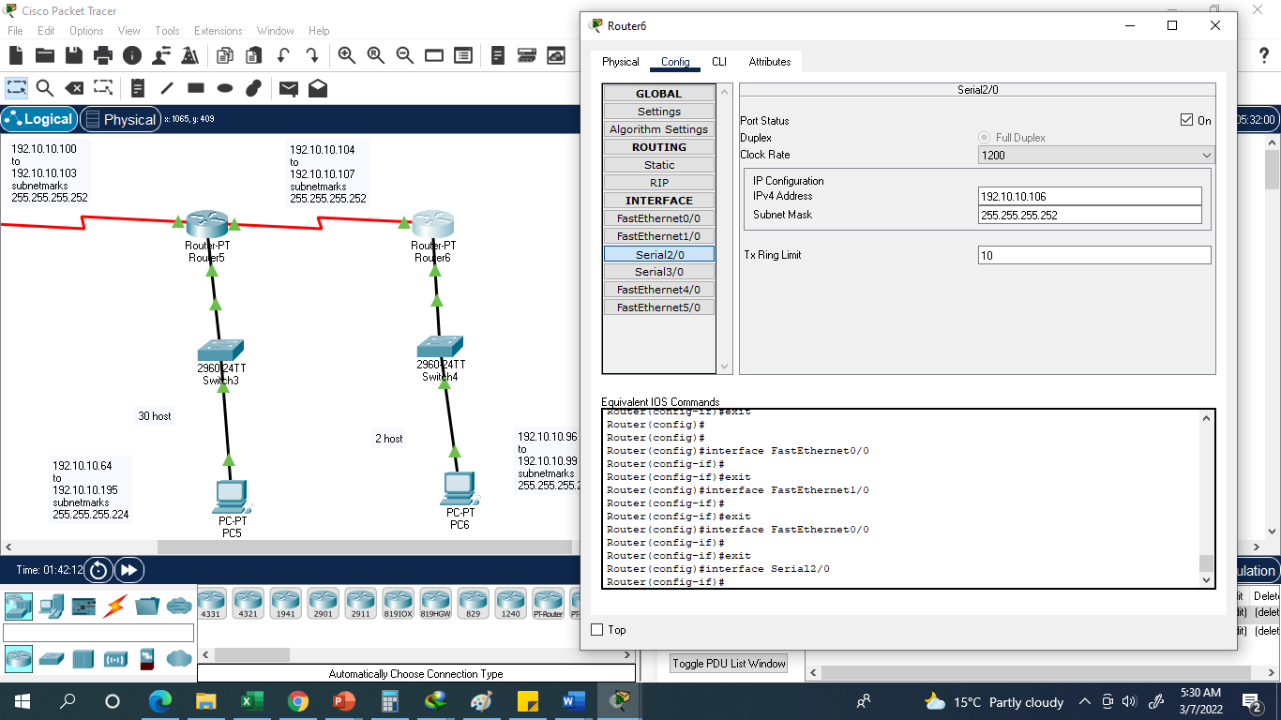

Slide 25
